Slide 1



Network Simulation using Cisco Packet Tracer
By:
N. Hemanth Srivathsav – 2010030113
Peri Vishwanadha Sastry – 2010030470
Abhiram Sharma – 2010030523

Slide 2
Abstract
In the process learning computer network systems, the use of virtual laboratories is very important.In this Project we will be using CISCO Packet Tracer Tool.
CISCO Packet Tracer is powerful Simulation Program that allows Us to experiment with Network Behaviour.
By using the CISCO tool we simulate complex scenarios on packet tracer and understand the real world applications of the network Layout with its networking Devices .

Slide 3

Introduction
This Project will be dealing with the Configuration of various components of a WAN (wide area network ) . Such as Connections between working Routers , Switches and Servers across the large coverage area under its range.
Network Simulation is a network modeling on a computer and testing how the network will work without being physically installed.
The vast majority of network simulator programs are programs used by companies developing network products for training and design purposes.
We will learn about various types of servers used in this project

Slide 4
Methods
One tool to simulation network protocols for the Internet is the CISCO Packet Tracer(CPT)
The simulation environment needs to be set-up carefully to produce meaningful results
The simulation set-up is called ‘Simulation Scenario’
Packet Tracer is a cross-platform visual simulation tool designed by Cisco Systems that allows users to create network topologies and imitate modern computer networks. The software allows users to simulate the configuration of Cisco routers and switches using a simulated command line interface.

Slide 5

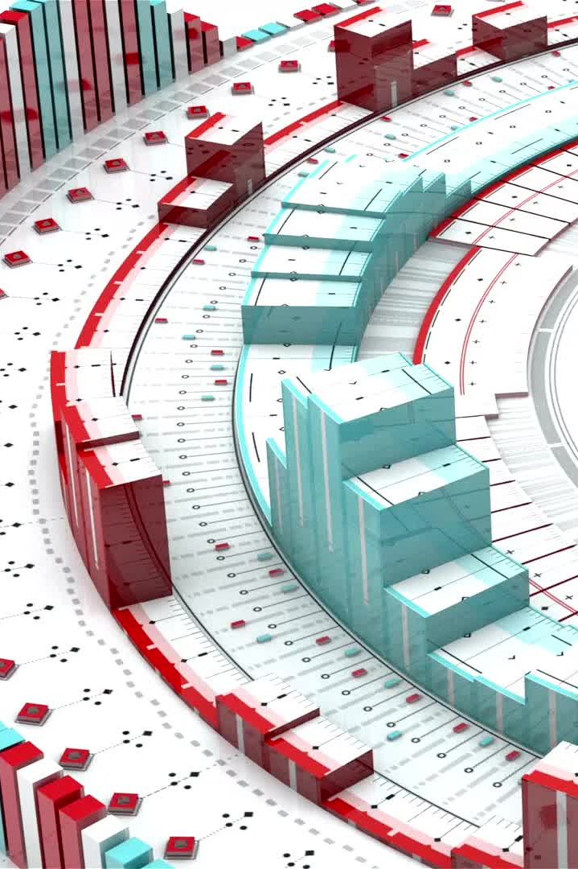
Why Simulation?
real-system not available, is complex/costly or dangerous eg: space simulations, flight simulations)
quickly evaluate design alternatives (eg: different system configurations)
evaluate complex functions for which closed form formulas or numerical techniques not available

Slide 6

Literature Survey
S.NO. | TITLE | METHODS | CRITICAL ASSESMENT
1. | Implementation Of CISCO PACKET TRACER In Computer Network | Network topology Command Line Interface (CLI) Scenario Configuration of routers and servers by following respected protocols. | 7 servers, 3 routers,3 switches,3 PCs including assigning of IP address to each of the devices.

Slide 7

Results
The Result will be produced by the Packet Tracer for the different scenarios.
In the Course of the study , we found out about the configuration of various switches , routers and servers and how they are implemented in real world.

Slide 8
Conclusion
Cisco Packet Tracer was not only used to simulate computer networks but also to learn computer networks .In this study we also saw that, Cisco Packet Tracer was implemented to design an advanced computer network. Everything that can be done in Cisco trainings were applied to this network simulation system. Finally, basic devices and protocols that were supposed to be in a network were used and as a result, it was seen that the network system was operated without any problem.

Slide 9

Thank you
Guided by:
Dr. Gayathri Edamadaka

